Slide 1


Rigid-Body Dynamics of Marine Structures
(Module 3)
Dr Tristan Perez
Centre for Complex Dynamic Systems and Control (CDSC)
Prof. Thor I Fossen
Department of Engineering Cybernetics
One-day Tutorial, CAMS'07, Bol, Croatia

Slide 2
Kinematics
Description of geometrical aspects of motion without regard to the forces that create the motion.
One-day Tutorial, CAMS'07, Bol, Croatia

Slide 3
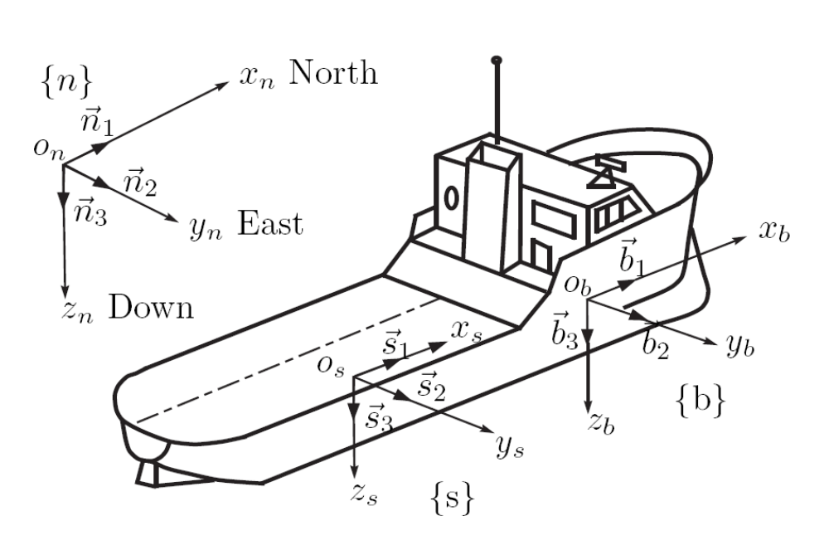
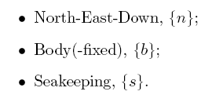
Ship Motion description
To describe the ship motion the following coordinate systems are used:
One-day Tutorial, CAMS'07, Bol, Croatia

Slide 4
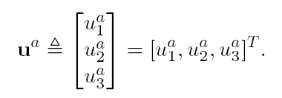
Vector notation
The vectors defined as directed line segments (coordinate free representation) belong a to a three-dimensional space:
Alternatively consider the coordinate vector representation in a given coordinate system as a 3x1 matrix:
Coordinate vectors are always given relative to a basis (coordinate system)
One-day Tutorial, CAMS'07, Bol, Croatia

Slide 5
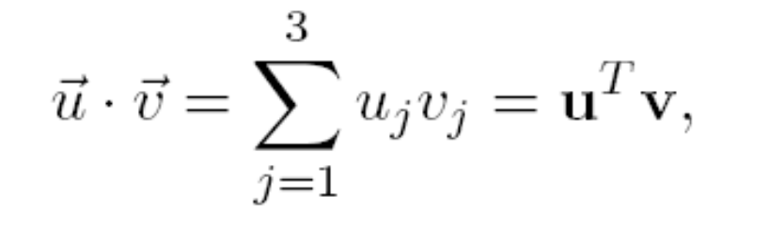
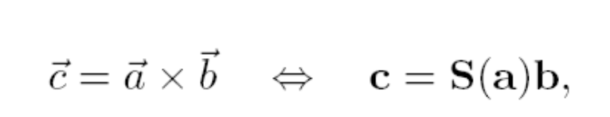
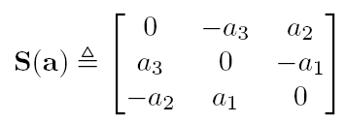
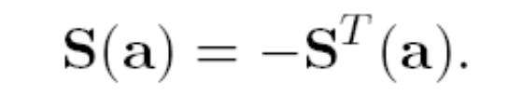
Dot and Cross products
Dot product:
Cross product:
Skew-symmetric form of a coordinate vector:
One-day Tutorial, CAMS'07, Bol, Croatia

Slide 6
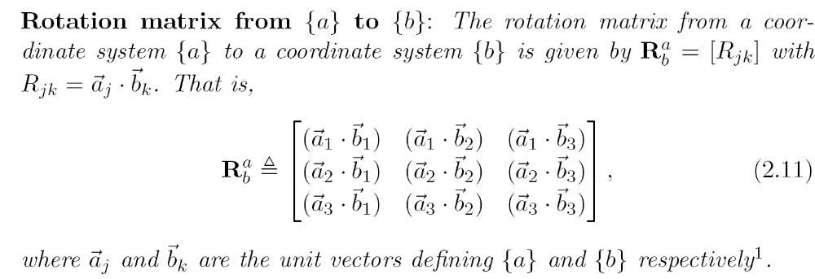
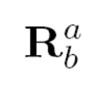

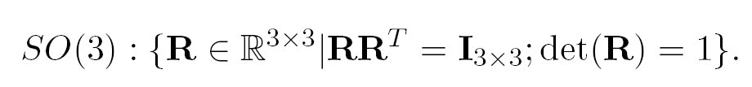
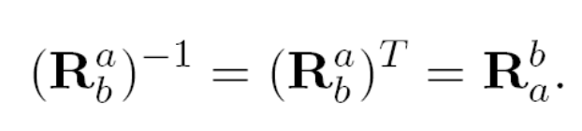
Rotation Matrices
One-day Tutorial, CAMS'07, Bol, Croatia

Slide 7
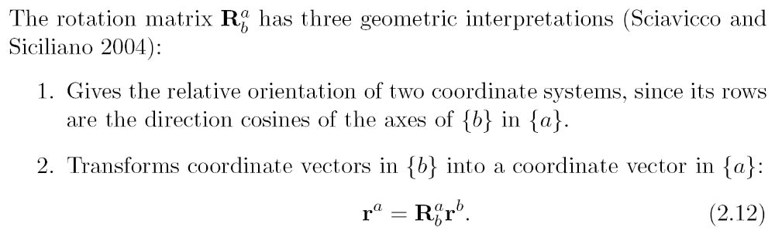
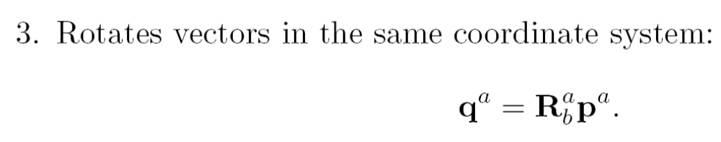
Interpretation of Rotation Matrices
One-day Tutorial, CAMS'07, Bol, Croatia

Slide 8
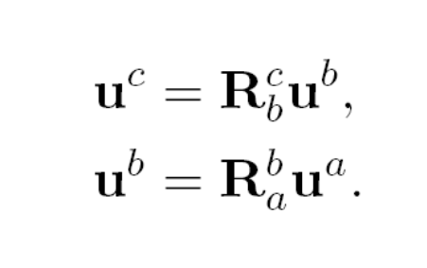
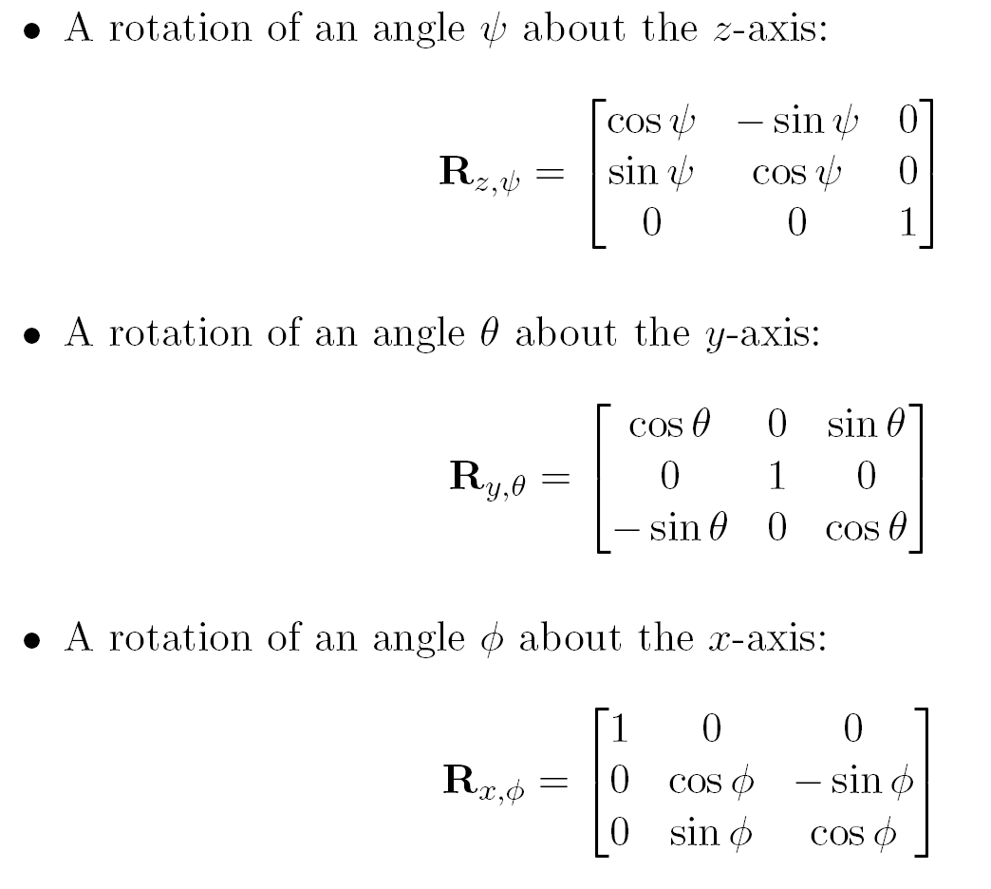

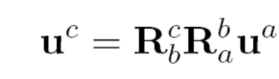
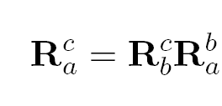
Single and Composite Rotations
Composite rotations:
Simple rotations about a coordinate axis:
One-day Tutorial, CAMS'07, Bol, Croatia

Slide 9
Euler Angles
The attitude of one coordinate system relative to another can be described by three consecutive rotations.
There are 12 ways of doing this depending on the order of the rotations, and each triplet of rotated angles is called a set of Euler Angles
One-day Tutorial, CAMS'07, Bol, Croatia

Slide 10
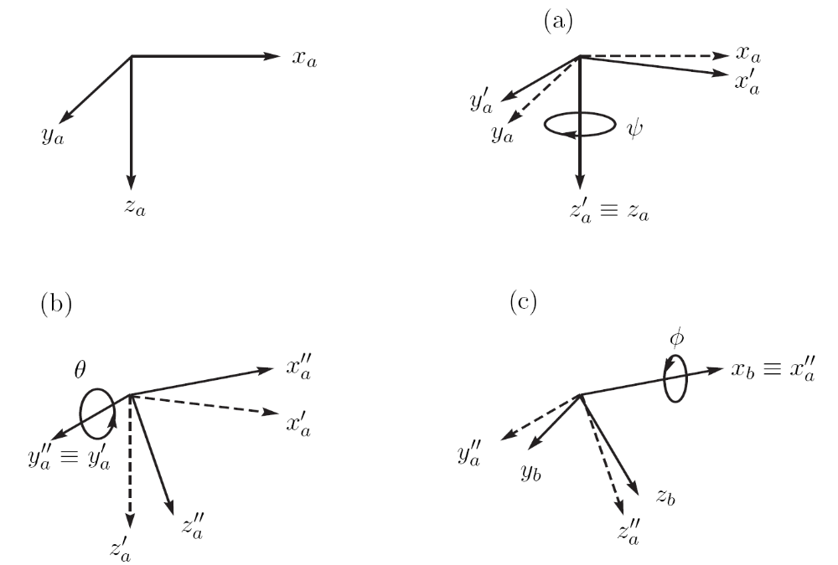
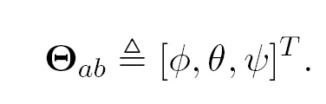
Roll, Pitch and Yaw
The roll, pitch and yaw is set of Euler angles commonly use in guidance and navigation.
Vector of Roll, Pitch and Yaw that take {a} into the orientation of {b}:
One-day Tutorial, CAMS'07, Bol, Croatia

Slide 11
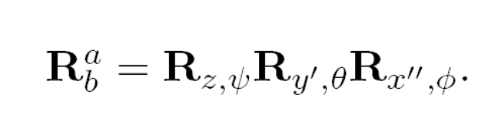
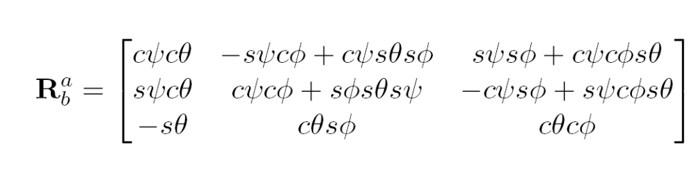



Rotation matrix in terms of RPY
After multiplication:
Note that the multiplication is consistent with the transformation
One-day Tutorial, CAMS'07, Bol, Croatia

Slide 12
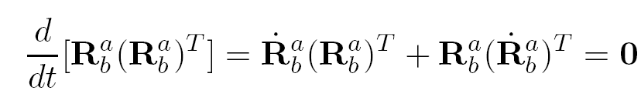

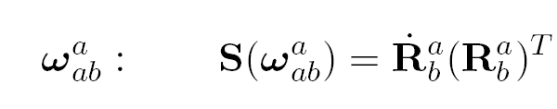
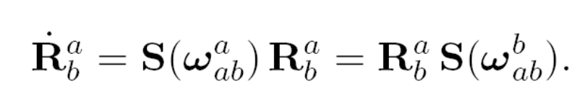
Angular velocity
Since the rotation matrix is orthogonal, then
This imply that is skew symmetric, and hence be represented by a single coordinate vector (Egeland and Gravdahl, 2002):
This is the angular velocity of {b} with respect to {a}, expressed in {a}
The derivative of the rotation matrix can then be expressed as
One-day Tutorial, CAMS'07, Bol, Croatia

Slide 13

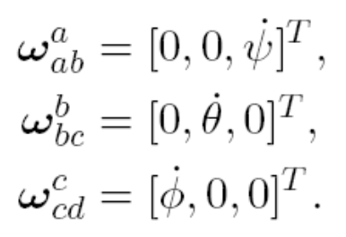
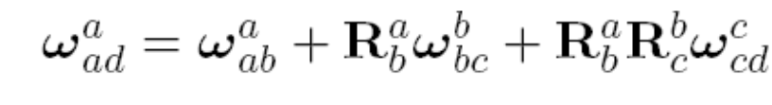
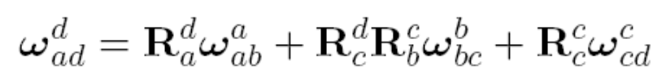
Angular velocity and deriv of RPY
Consider a rotation from {a} to {d} via RPY:
The angular velocities are
Then from the theorem of addition of angular velocities we have
One-day Tutorial, CAMS'07, Bol, Croatia

Slide 14
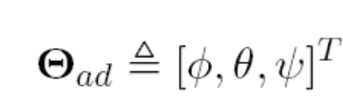
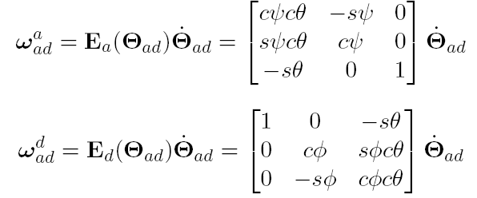
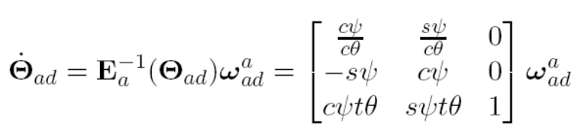

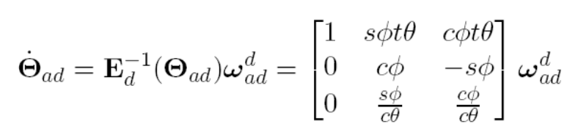
Angular velocity and deriv of RPY
From
using,
we obtain
The angular velocity and the derivative of the Euler angles are, in general, different things.
One-day Tutorial, CAMS'07, Bol, Croatia

Slide 15
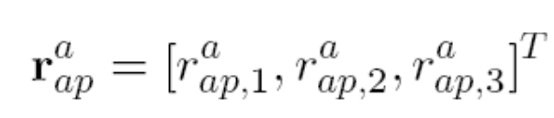
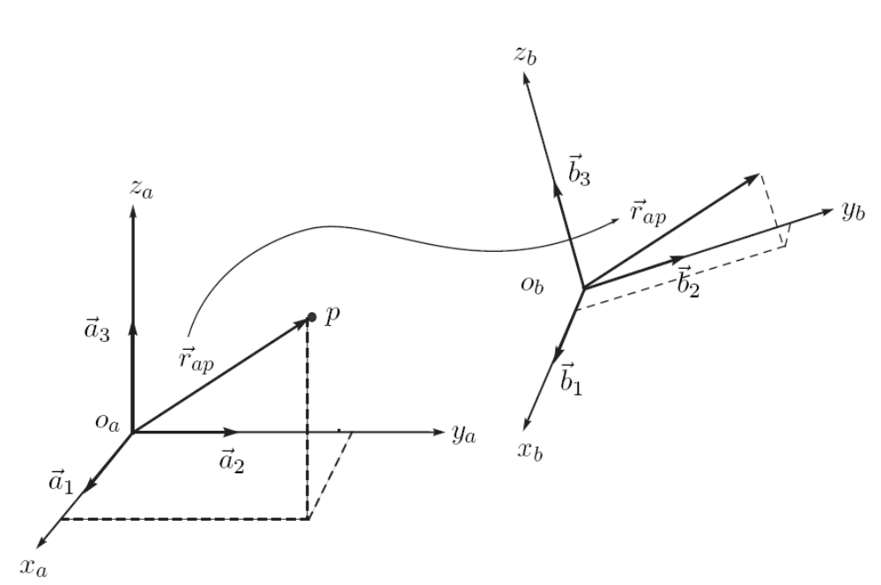
Position
Position of “p” with respect to {a}, and expressed in {a}:
Coordinate system where the vector is expressed
Point of interest
Position of “p” with respect to {a}, and expressed in {b}.
Reference coordinate system
Note that a change in coord sys does not change the position vector; it is still p in {a}.
One-day Tutorial, CAMS'07, Bol, Croatia

Slide 16


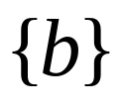
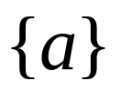
Velocity
The relative position of any two points is invariant in any coordinate system (||r1-r2|| is independent of the coordinate system used to express r1 and r2).
The velocity depends on the coordinate system adopted.
{b} and “p” rotate with angular velocity ω.
The velocity of “p” wrt {b} is zero, but not wrt {a}.
One-day Tutorial, CAMS'07, Bol, Croatia

Slide 17
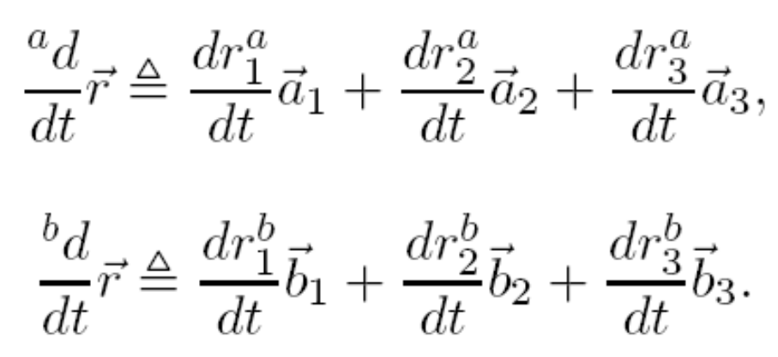
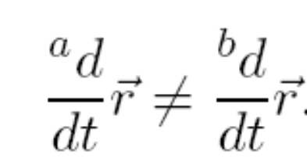
Derivative of a vector
The derivative of a vector makes no sense without specifying the coordinate system with respect of which the derivative is taken:
In general
One-day Tutorial, CAMS'07, Bol, Croatia

Slide 18
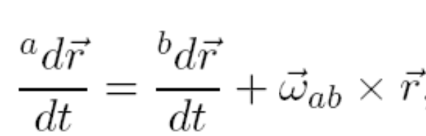

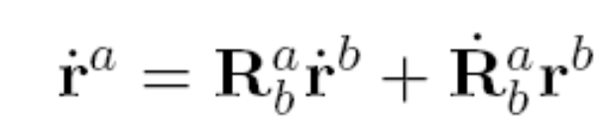
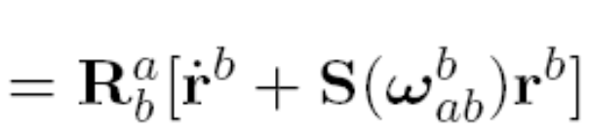

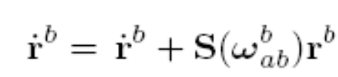
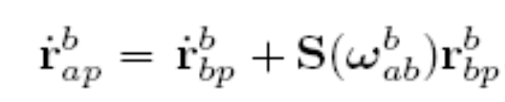
Transport Theorem
In coordinate form
We need to use double script so we don’t have this problem in notation:
If we multiply both sides by
?
One-day Tutorial, CAMS'07, Bol, Croatia

Slide 19
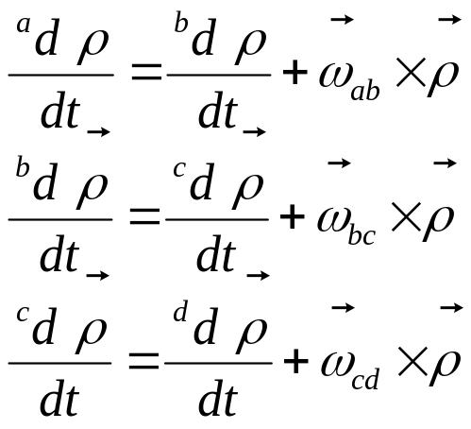
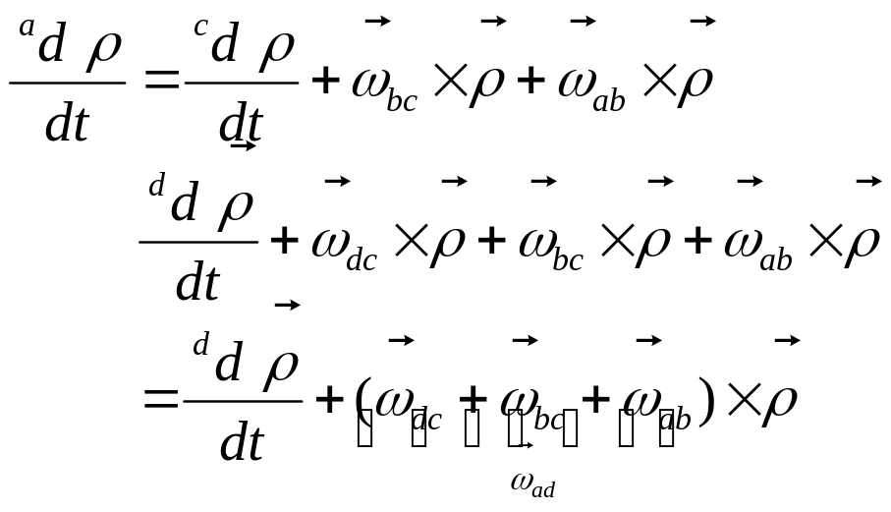
Sum of angular velocities revisited
This one is easier to show in coordinate-free form:
Then
It is convenient to be familiar with both coordinate and coordinate-free representations, for some derivations are easier in one form than in the other.
One-day Tutorial, CAMS'07, Bol, Croatia

Slide 20
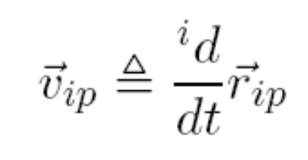

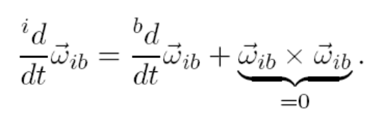

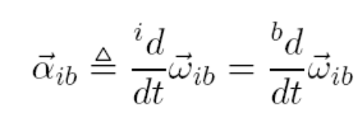
Velocity and Acceleration
If {i} denotes an inertial coordinate system, then
The first subscript Indicates the coordinate system with respect of which the derivative is taken
Angular acceleration
Linear acceleration:
One-day Tutorial, CAMS'07, Bol, Croatia

Slide 21
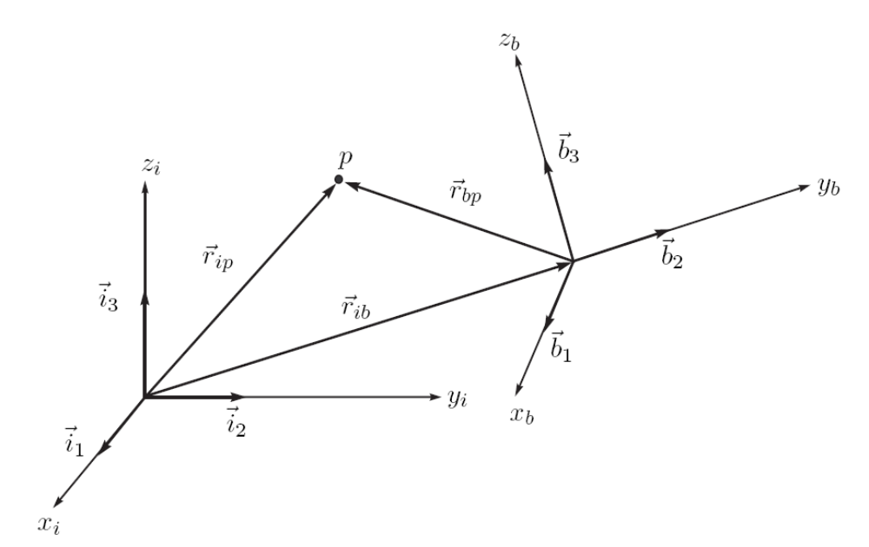
Motion in different coord systems
Not inertial
inertial
One-day Tutorial, CAMS'07, Bol, Croatia

Slide 22
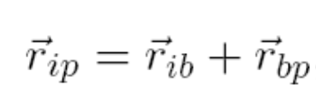
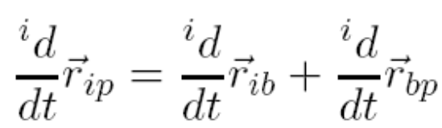


Motion in different coord systems
Transport Theorem
In coordinate form
One-day Tutorial, CAMS'07, Bol, Croatia

Slide 23


Motion in different coord systems
Taking a derivative again:
With the adopted notation
One-day Tutorial, CAMS'07, Bol, Croatia

Slide 24
Ship kinematics
Ship kinematics is different depending on the assumptions made to describe the motion:
Manoeuvring
Seakeeping
One-day Tutorial, CAMS'07, Bol, Croatia

Slide 25



Manoeuvring Kinematics
In manoeuvring, the position of the vessel is given by the position of of {b}-body-fixed coordinate system with respect to {n}-North-East-Down coordinate system.
The attitude is given by the angles of roll, pitch and yaw that take {n} into the orientation of {b}.
One-day Tutorial, CAMS'07, Bol, Croatia

Slide 26




Vessel linear velocities
The velocities are more conveniently expressed in {b}-body-fixed coordinate system:
surge
sway
heave
Note that the following integral has no physical meaning:
Ship trajectory:
One-day Tutorial, CAMS'07, Bol, Croatia

Slide 27



Vessel angular velocities
The angular velocity expressed in {b}-body-fixed coordinate system is
roll
pitch
yaw
Note that the following integral has no physical meaning:
Which is the relationship we have already shown between the ang vel and the derivative of the Euler angles.
The ship orientation is obtained integrating
One-day Tutorial, CAMS'07, Bol, Croatia

Slide 28


Generalised position and velocity
We define the coordinate position-orientation vector (Fossen, 1994):
We define the coordinate linear-angular velocity vector (Fossen, 1994):
One-day Tutorial, CAMS'07, Bol, Croatia

Slide 29





Kinematic model {n}-{b}
Then,
Note that
Because is not orthogonal.
One-day Tutorial, CAMS'07, Bol, Croatia

Slide 30

Summary manoeuvring coordinates
Perez, T. and T.I. Fossen (2007)
One-day Tutorial, CAMS'07, Bol, Croatia

Slide 31




Seakeeping kinematics
In seakeeping, the motion is described from a reference frame which represents the equilibrium position and orientation of the vessel.
Then the action of the waves makes the vessel oscillate with respect to this equilibrium
Definition of equilibrium reference frame:
Vessel average forward speed.
One-day Tutorial, CAMS'07, Bol, Croatia

Slide 32



Seakeeping coordinates
In a similar fashion as we did in manoeuvring, we can define the perturbation body-fixed linear and angular velocities
Perturbation roll, pitch and yaw:
One-day Tutorial, CAMS'07, Bol, Croatia

Slide 33



Seakeeping coordinates
Further, we can define the perturbation position an velocity vector:
In the hydrodynamic literature, the following variables are used:
The kinematics transformation is
simplified under the assumptions of
very small angles
One-day Tutorial, CAMS'07, Bol, Croatia

Slide 34

Summary seakeeping coordinates
Perez, T. and T.I. Fossen (2007)
One-day Tutorial, CAMS'07, Bol, Croatia

Slide 35
Kinetics
Description of forces and the motion they cause on bodies using postulated laws of physics.
One-day Tutorial, CAMS'07, Bol, Croatia

Slide 36





Forces and moments
A force acting on a rigid body has a line of action which passes through the point of application.
This means that the force produces a moment about a point.
any point on the line of action
Line of action
One-day Tutorial, CAMS'07, Bol, Croatia

Slide 37


Forces and moments
A resultant force due to a set S of forces acting on a rigid body is
The resultant does not have a line of action.
A resultant moment due to a set S of forces acting on a rigid body is
One-day Tutorial, CAMS'07, Bol, Croatia

Slide 38





Moment about another point
The moment about a point Q can be found
The resultant can be regarded as a force with line of action through P
One-day Tutorial, CAMS'07, Bol, Croatia

Slide 39


Transformation
Using the previous results we have that in body-fixed coordinates
If we choose Q = Ob, then
One-day Tutorial, CAMS'07, Bol, Croatia

Slide 40



Rigid-body mass and inertia matrix
The generalised mass matrix with inertia moments and products taken about the origin of {b} is
Inertia matrix taken about the origin {b} can be expressed by the one taken about CG (Parallel axis theorem):
The notation “b/” means about; e.g. b/g means about CG
The parallel axis theorem can only be use between CG and another point. So if we want to convert between two arbitrary points we have to do it in two steps.
One-day Tutorial, CAMS'07, Bol, Croatia

Slide 41



Angular momentum
The angular momentum about CG in B is given by
If this is expressed in the inertial coordinate system {i},
This shows that inertia matrix is not constant in an inertial frame {i} if {b} rotates wrt {i}. Hence, it is convenient to express the equations of motion in a body-fixed coordinate system.
One-day Tutorial, CAMS'07, Bol, Croatia

Slide 42




Euler’s Axioms
Euler’s 1st axiom states that:
-is the velocity of CG relative to {i} and expressed in {i}
-is the vector of resultant forces.
Euler’s 2nd axiom states that:
Angular momentum about CG
Resultant moment about CG
One-day Tutorial, CAMS'07, Bol, Croatia

Slide 43


Rigid-body Equations of motion
Expressing the velocities in the body-fixed coordinate system—located at an arbitrary point in the body, the Euler axioms become
One-day Tutorial, CAMS'07, Bol, Croatia

Slide 44


Ship RB eq of motion
Following the notation of Fossen (2002):
Generalised positions
Generalised velocities
Generalised forces
One-day Tutorial, CAMS'07, Bol, Croatia

Slide 45



Coriolis and Centripetal terms
The Coriolis-centripetal terms can be expressed as
where
← Separated into linear and anglular
One-day Tutorial, CAMS'07, Bol, Croatia

Slide 46

RB Equations of motion in 6DOF
In coordinate form:
One-day Tutorial, CAMS'07, Bol, Croatia

Slide 47

Changing the body-fixed system
In different applications it is necessary to consider different locations for a body-fixed coordinate system.
Hence we may want to transform the equations of motion from {b} to {p}
One-day Tutorial, CAMS'07, Bol, Croatia

Slide 48



Changing the body-fixed coordinates
This can be done by direct application of the transformations we have already derived:
Hence,
One-day Tutorial, CAMS'07, Bol, Croatia

Slide 49
Seakeeping RB equations of motion
In Seakeeping, the equations of motion are considered within an linear framework.
In the literature, it is said that the motion is described from the equilibrium reference frame and formulated at the origin of {s}—seakeeping coordinate system.
This would imply that the inertia matrix is time varying as we have seen in the previous slide, but this is not the case.
One-day Tutorial, CAMS'07, Bol, Croatia

Slide 50




Seakeeping RB equations of motion
The seakeeping RB eq. can be obtained by considering the equations of motion in body-fixed coordinates and considering only linear terms:
Perturbation Eq in
body-fixed coord.
Perturbation within
Linear framework
Seakeeping RB Eq.
of motion:
One-day Tutorial, CAMS'07, Bol, Croatia

Slide 51
References
Egeland, O. and J.T. Gravdahl (2002) Modelling and Simulation for Automatic Control. Marine Cybernetics.
Kane, T.R., and D.A., Levinson (1985) Dynamics: Theory and Applications. McGraw Hill series in Mech Eng.
Fossen, T.I. (2002) Marine Control Systems. Marine Cybernetics.
Perez, T. (2005) Ship Motion Control. Springer.
Perez, T. and T.I. Fossen (2007) Kinematic Models for Seakeeping and Manoeuvring of Marine Vessels. Modeling, Identification and Control, MIC-28(1):1-12, 2007.
Sciavicco, L. and B. Siciliano (2001) Modelling and Control of Robot Manipulators. Springer Advanced Textbooks in Control and Signal Processing.
One-day Tutorial, CAMS'07, Bol, Croatia

